Slide 1
STUDENT NAME: SHANMUGAPRIYAN S REGISTER NO AND NMID :222403564/sshanmugapriyan24137bsccs@gmail.com DEPARTMENT: BSC COMPUTER SCIENCE COLLEGE: SRIDEVI ARTS AND SCIENCE COLLEGE/madras university
Digital Portfolio

Slide 2
PROJECT TITLE
BIKE BOOKING SHOWROOM

Slide 3
AGENDA
Problem Statement
Project Overview
End Users
Tools and Technologies
Portfolio design and Layout
Features and Functionality
Results and Screenshots
Conclusion
Github Link

Slide 4
PROBLEM STATEMENT
Build a stylish and responsive “bike booking website” that allows users to view available bikes and “book a bike” by filling out a form. The site should confirm the booking with user details and offer a smooth user experience with interactive design and animations.

Slide 5
PROJECTOVERVIEW
This project is a “bike booking website” for the "Shanmuga Bike Showroom." It showcases a selection of bikes and allows users to “book their preferred bike” by submitting a simple form. The site features an attractive design, smooth interactions, and a confirmation message upon successful booking.

Slide 6
WHO ARE THE END USERS?
Bike enthusiast
Potential buyers
Students or commuters, looking for personal transport
Customers comparing bike models before purchase.

Slide 7
TOOLS ANDTECHNIQUES
* HTML* – for webpage structure*
*CSS* – for styling and layout*
*JavaScript* – for interactivity and form handling*
*Responsive Design* – for mobile and desktop compatibility*
*Google Fonts* – for custom font styling

Slide 8
POTFOLIO DESIGN ANDLAYOUT
* A vibrant *header* and title*
A *bike gallery* displaying available models*
A *bike-themed booking form*
* Stylish buttons, animations, and hover effects* A clean *footer* with copyright info

Slide 9
FEATURES ANDFUNCTIONALITY
Display of multiple *bike models with images
"Book Now"* button for each bike
Interactive *booking form* with name, date, and selected bike
Auto-fill bike name* when booking Confirmation message after booking
Fully responsive and animated UI

Slide 10
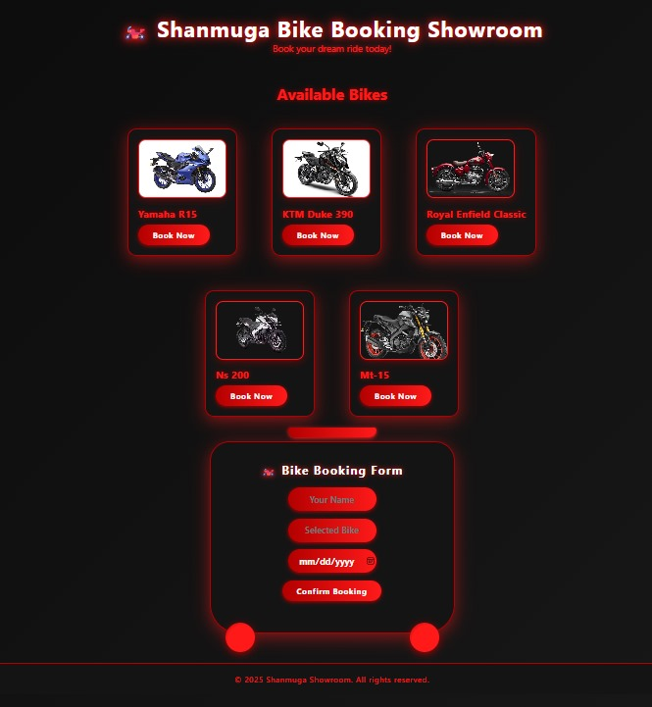
RESULTS AND SCREENSHOTS
The website successfully displays a list of bikes with images and names.
Users can click “Book Now” to auto-fill the booking form.
Booking confirmation is shown after submitting the form.
The design is responsive and visually appealing with animations.
Screenshots:

Slide 11
CONCLUSION
The Shanmuga Bike Booking Showroom website makes it easy for users to view bikes and book them online. With a clean design and interactive features, it improves the customer experience and streamlines the booking process for both users and showroom staff.

Slide 12
GitHub Link
https://github.com/shanmugapriyan24137/TNSDC-PWD-DP1.git

